Slide 1
Strategic Planning and Performance Group of the Department of Health
Joining the NI Dental List

Slide 2
Areas to be covered today
Part 1
HSC structure
Main roles
Minimum standards
GDS Regulations
SPPG – Dental
Forms- HS48 & HS50
COVID in Practice
Part 2
Record keeping
RDS
Probity Service
Prior Approval
Part 3
Individual responsibilities
Part 4
Out Of Hours clinics
Part 5
Adverse Incidents/SAIs
Complaints
Referrals to specialists
Occupational Health
Part 6
Orthodontic issues
Part 7
Dental Prescribing Issues

Slide 3
Part 1- HSC structures
DoH/Minister
RQIA
RQIA
CDO
Policy
SPPG
LCGs
NIMDTA
BSO
GDPs/GPs/ Independent & Private Sector/ Voluntary & Community
PHA
Trusts
PCC

Slide 4
Main roles
Healthcare Policy Group of the Department of Health
Minister + civil servants advising politicians in The Assembly
Formulates and sets policy
the GDS regulations
the SDR
sets the Dental Budget
negotiates contracts

Slide 5
Main roles
Strategic Planning and Performance Group of the Department of Health (SPPG)
Implements policy, the GDS Regulations and the SDR set by the Healthcare Policy Group
Makes arrangements with contractors (dentists) within a budget set by the Healthcare Policy Group
Monitors performance of the dentists – RDS and Probity reviews, prescribing, CA and PR compliance
Takes action as required. In relation to dentistry this is done directly with GDPs, practitioners in any pilot (PDS) and salaried GDPs.

Slide 6
Main roles
Chief Medical Officer Group of the Department of Health
Chief Dental Officer
Provides professional support to the Minister, MLAs, and civil servants

Slide 7
Main roles
RQIA
Registers and inspects all dental practices where ANY private work is carried out (SPPG inspects all practices that declare themselves wholly health service)
Trusts – secondary care and CDS
Are commissioned (in relation to dentistry) to provide hospital and community dental services
Patient and Client Council (PCC)
Advocates on behalf of patients

Slide 8
Business Services Organisation ‘BSO’
“broad range of business support functions and specialist professional services to the health and social care sector in Northern Ireland”
Family Practitioner Services (primary care) Medicine, Pharmacy, Dentistry, Ophthalmic
Dental services for patients and contractors e.g.
Dental list
Dental payments
Clinical audit

Slide 9
Minimum Standards for Dental Care and Treatment (Dept. of Health)
Describes the standards of care to be provided from the patient’s perspective
There are 15 Standards
Applicable to both health service and private care.
These may form the theme(s) for RQIA practice inspections and include:
- Choosing your dental service
-The quality of your care and treatment
- Medical and other emergencies
- Children, young people and vulnerable adults
https://www.health-ni.gov.uk/publications/professional-dental-guidance-publications
Notes:
Web link provided in Slide 80 (Titled-Handouts) of presentation.

Slide 10
General Dental Services Regulations (Terms of Service)
Please note that these Regulations apply to individual practitioners and not to practices
For all dentists on the Dental List
Principal/Associate/Assistant/Deputy
Role of corporates
https://bso.hscni.net/directorates/operations/family-practitioner-services/dental-services/contractor-information/gds-regulations-ni-1993/

Slide 11
General Dental Services Regulations (Terms of Service)
Key areas:
Care quality
Infection Control standards met
Health and Safety Compliance
Radiological Regulations Compliance
CPD compliance (both clinical audit, and peer review and GDC requirements)
f. Compliance with QA returns (practice based)

Slide 12
Statement of Dental Remuneration
List of health service dental treatments and their associated codes and fees
Statement of Dental Remuneration (SDR) - Business Services Organisation (BSO) Website

Slide 13
Michael Donaldson
AD(D)
Donncha O’Carolan / William Priestley
Joint Regional Lead – GDS and Governance
Sinead Preston
Regional Lead – CDS, HDS and Public Health
8 Dental Advisers (~6 WTE)
Structure of the SPPG - Dental

Slide 14
8 Dental Advisers DAs (~6 WTE)
Joe McGrady (South Eastern LCG / BSO)
Jonathan Montgomery (Northern LCG / BSO)
David Marshall (RQIA / BSO/ Dental Prescribing)
William Priestley (Belfast LCG / RDS) Julie Collins (Southern LCG / Orthodontics / RDS)
Julie Kelly (Northern LCG / OS pilot)
Derek Maguire (Southern LCG / OOH / Probity)
Gerry Cleary (Western LCG / Probity)
Antoinette Toner (Western LCG / Probity)
queries to GDS correspondence: GDS.Correspondence@hscni.net

Slide 15
GDPs– how to access information
GDS Correspondence
Contractor Information - Business Services Organisation (BSO) Website
Telephone - email - in person –DAs
Local Dental Committees
New Starts presentation
Talks during FD year
Postgraduate courses

Slide 16
Local Dental Committee
The LDCs in Northern Ireland are endorsed by the BDA and provide support, guidance and advocacy for NHS dentists in their regions.
Contact Information for Local Dental Committees
Eastern LDC: ealdcsec@hotmail.co.uk
Northern LDC: northernldcni@gmail.com
Southern LDC: southernldc@hotmail.com
Western LDC: chairwesternldc@hotmail.com

Slide 17
SPPG Office Contact Numbers:
Directorate of Integrated Care:
Northern Office 028 953 62849
Belfast Office 028 953 63926
South East Office 028 953 63926
Southern Office 028 953 62104
Western Office 028 953 61010

Slide 18
Forms available from the BSO website
HS48
Dental List application form + FAQs available at same link
New Entrants to the NI Dental List (hscni.net)
HS50 - Block Transfer Form
It is very important that arrangements are made for full patient transfer otherwise patients could technically be deregistered
Part 1 should be completed by the practitioner with whom the patients are registered
Contact: professionalSupportTeam@hscni.net
Notes:
.
HS48 form Completion and acceptance of the form gives you entry onto the Board’s dental list to provide General Dental Services.
Submission is followed by you being supplied with your DS number to identify you and pay you
Please be advised this incident happened to a VT practice last year with
significant impact on the income of the practice and caused the principal
considerable stress. All the patients had to be contacted and reregistered
by the practice, with no income for the practice in the intervening period
which can take months. This would be regarded as an adverse incident in
practice governance.
Contact number at the BSO regarding the HS50 Block form
is Mrs. Gillian Weir—02890535649

Slide 19
GDS Income
Item of service – SDR codes
Capitation payments – adults and under 18s
Allowances – individual and practice
HSC Pension scheme

Slide 20
GDS Income

Slide 21
HSC Pension Scheme
Notify SPPG about the start of Superannuable Employment by completing the form in the HS48 application (even if you opt out of the scheme).
Further information on the Scheme can be obtained via the following link:
HSC Pension Service (hscni.net)

Slide 22
Individual payments
Maternity, paternity and adoption leave
Long-term sickness
Continuing professional development allowance
Clinical audit and peer review
Seniority
Health Service earnings thresholds are applicable
Claim forms available for download at:
Forms Library - Business Services Organisation (BSO) Website

Slide 23
Practice payments
Practice allowance
Rates reimbursement
“one-off” payments e.g. a revenue grant scheme to target a need in primary care dentistry
These payments are paid directly to the practice owner(s)

Slide 24
The BSO Dental Portal
January 2019
Reduction in paper based communications from BSO to practitioners
Useful during pandemic
BSO Dental Portal - Business Services Organisation (BSO) Website
Please refer to our colleagues in the BSO for advice.

Slide 25
Transferring or Leaving practice
For advice on joining or withdrawing from the Dental List / switching practice contact: : ProfessionalSupportTeam@hscni.net
Provide 3 months notice in writing to BSO
Inform your local office and Dental Adviser (DA)
If transferring a patient list - complete HS50- Block transfer form
Make appropriate emergency cover/contact arrangements with the practice principal/other associates
Full advice available in:
“Guidance for GDS Practitioners: Dealing with Practice Changes”
which is available to download from the BSO website at: Governance - Business Services Organisation (BSO) Website

Slide 26
Leaving practice - GDC
Contact GDC if intentionally withdrawing from the register otherwise you will appear on the next calendar year’s “Removals due to Non Payment list”, which is forwarded to SPPG Dental Advisers for action.
Be careful if long-term sick or taking a career break and “to save money” a decision is made to drop GDC registration for a year or two!
This could affect Pensions

Slide 27

Overview Part 2
Record Keeping
Monitoring
Notes:
Kylemore Abbey
Next section is probity and RDS

Slide 28
Records
The importance of keeping records
“If it isn't written down - it didn’t happen”

Slide 29
Why do we need clinical records?
To satisfy legal or regulatory requirements
The content of records is the responsibility of the dentist (even when dictating to someone else)
To verify treatment
To assure a third party
RDS
Probity
Prior Approval
GDC
PSNI
Lawyers

Slide 30
Riskwise Jan 2017
‘…..the critical aspect of record keeping is that
a third party needs to be able to read and
understand the records and subsequently
know exactly what has happened and when………….’’

Slide 31
Who is the third party ?
Patient or their representative
Prior approval
RDS service
Probity services
Legal
PSNI
GDC

Slide 32
Patient Record Definition
Everything relating to the patient’s treatment, i.e.
Record card, HS45, HS45PR, HS45DC, DB114(Ortho), Radiographs, photographs, study models, receipts, lab documents, Statements of Manufacture(SOM), details of prescribed drugs, etc.
Medico legal... Referral letters and reports are also included in the definition above.
Patient records must be retained for 6 years (GDS Regs).
Notes:
A valid HS45PR form requires:
A Claim Reference Number
The dentist’s name, address and contract number
Evidence of exemption/remission seen/not seen
The patient’s DOB and CHI
Completed exemption/remission status
The patient’s signature(s) and dates(s) on parts C or D and on part E.

Slide 33
Referral Dental Services
Monitor the quality of health service dental treatment
Quality of care
Quality of record keeping
Compliance with GDS Regulations
Compliance with IR(ME)R
Probity
Provide information for policy makers

Slide 34
What the RDS looks like
Three yearly cycle
Records Review- 10 records submitted for a desktop review
Patient Examinations suspended during the pandemic
Follow-up where necessary

Slide 35
Learning points from recent reviews
Quality of care
Non-treatment of diagnosed disease
Radiograph interpretation
Record keeping - Contradictory records
“non-smoker” “advice given on smoking cessation”
“no caries noted clinically” BWs and fillings suggest otherwise
“no LA used” “LL5 forceps extraction”
“UL4 extracted” “warning re numbness in L.Lip and chin”

Slide 36
Probity Services
Correct payment for necessary and appropriate activity carried out by qualified persons in accordance with Regulations (see slides 10 and 11).

Slide 37

Verification
A Probity Review checks:
Claim against Payment for accuracy
If treatment was carried out
If treatment was necessary
Quality of treatment
If the patient exists

Slide 38
Who is selected for a probity review?
Contractors will be selected on the following basis:
Randomly
Quarterly monitoring reports (profiles) identifies outliers
Receipt of information/concerns raised elsewhere, whistle-blowers, complaints, Referral Dental Service
Repeated issues/errors
30-50 contractors selected each quarter
50% selected randomly
50% selected from other areas

Slide 39
What is an outlier?
Volume of claims -number and value
Average cost per claim
Exemption/remission vs non-exempt patients appear to have different prescribing patterns
Unusual claim patterns e.g. split estimates – incomplete treatment

Slide 40
Codes to look out for
0111 charting and BPE recorded
1011 perio > 1 visit but not on same day!
1441 evidence of early caries in record or caries removal as item 1441 is a restoration
1501 Incomplete root filling-discretionary fee (post-op rad)
2201 soft tissue extraction – flap/sutures recorded
1742/3 temporary crown provided before Prep appointment
1425 buccal cusp tip in first molars
2941 heat cured occlusal appliance (BG) adjustments

Slide 41
Codes (continued)
3701 acute conditions – pericoronitis, ulcers, herpetic lesions
but NOT chronic abscesses or ‘dry sockets’
2311 Treatment of infected sockets

Slide 42
Prior Approval Process
BSO Dental Officers review cases on behalf of the Dental Committee
Pre-treatment Examination
Carry out necessary emergency treatment
Seek approval when:
a) total fee for proposed course of treatment exceeds £380
b) individual code attracts a discretionary fee e.g. r/c veneer
Dentist will be notified of outcome by form DB26 and may wish to appeal if unhappy with the decision
Dental Committee - Appeals Procedure

Slide 43
Dental Committee
Statutory Committee
Chairman appointed by Minister
Six experienced GDPs (4 nominated by LDCs + 1 DPC (BDA) representative + 1 BSO nomination
All identifiers on records/models etc redacted- each case judged on clinical merits
Committee usually meets 4-6 weekly at the BSO
Further appeal available to DoH – CDO decision or outside specialist referral
Notes:
Between January 2011 and December 2011, there were 143 cases sent to the Dental Committee
41 were Orthodontic cases
were General Cases
10 Orthodontic cases were approved by the Dental Committee
13 General cases were approved by the Dental Committee
31 Orthodontic cases were not approved by the Dental Committee
89 General cases were not approved by the Dental Committee

Slide 44
Management of Underperformance
Peer to peer engagement by Case Officer resulting in:
Action plans
Targeted CPD
Mentorship
Clinical audit
Follow-up reviews
Referral to the “Regional Professional Panel”
Refer to NHS Resolution / GDC / PSNI /Reference Committee
Referral to the HSC Disciplinary Procedures
Notes:
Between January 2011 and December 2011, there were 143 cases sent to the Dental Committee
41 were Orthodontic cases
were General Cases
10 Orthodontic cases were approved by the Dental Committee
13 General cases were approved by the Dental Committee
31 Orthodontic cases were not approved by the Dental Committee
89 General cases were not approved by the Dental Committee

Slide 45

Overview Part 3
Individual responsibilities
Notes:
Keel Bay, Achill

Slide 46
Individual responsibilities
Cross Infection control (DoH PEL (13)13 is the NI guidance)
IR(ME)R
Data handling and data protection
CPD and Clinical Audit and Peer Review
Mixing HS and Private care
NHS +
IV sedation
Notes:
Information Governance leaflet in pack

Slide 47
“Infection control is everyone’s business and it is important that all members of staff observe good infection control practice”
(Teare et al. J Hospital Infection 2001; 48:312-319)
In relation to endodontics remember that files are single use, NOT single patient

Slide 48
IR(ME)R 2000
all radiographs must be:
Justified - only determined by examination of the patient
Quality assured - Poor quality radiographs may lead to fee recovery for that and associated items. ‘not acceptable’ (NA) radiographs must always have a report in the records (even if not making a payment claim)
Recorded a clinical evaluation of the outcome of each exposure made in the patient notes
IRR99 also applies
See “Prescribing radiographs in GDS Practice” and letter from Michael Donaldson of 19 Sept 2011(BSO website)
Notes:
All radiographic exposures should be preceded by justification in the patient records and a clinical evaluation/report provided.
The SDR states that the fee includes the report.
If radiographs are reviewed as part of a probity or quality of care review, and no reports are noted or available- the fee/s will be recovered and further reviews recommended.

Slide 49
Grading
“Aim of dental radiography is to produce an image of adequate quality for diagnostic purposes while minimising patient dose as far as reasonably possible”
Old NRPB system of 1, 2, 3 replaced with:
‘A’ – acceptable ‘NA’ - not acceptable
Target for Digital is 95% (Film 90%)

Slide 50
Regulations on X-Ray Use - IRR17 and IRMER18
The Ionising Radiation Regulations 2017 (IRR17) - has replaced IRR99, and IRMER (NI)
Ionising Radiation (Medical Exposure) Regulations 2018 (IRMER18) - has replaced the original IRMER 2000 (and amendments from 2006 and 2011) as of February 2018.
The Faculty of General Dental Practitioners (FGDP) has published an article on the implications for General Dental Practitioners which can be found at:
https://www.fgdp.org.uk/news/updated-new-regulations-x-ray-use-likely-implications-irr17-and-irmer18.

Slide 51
Data handling and data security
Personal legal obligation to protect and process patient information in line with the Data Protection Act 1998
Personal information can only be used for the purposes that it is collected for and for HSC monitoring purposes
Sanctions can be financial and there could also be criminal convictions
See links to advice sheets on BSO website

Slide 52
General Data Protection Regulation (GDPR)
UK GDPR guidance and resources | ICO
Was implemented on 25 May 2018

Slide 53
CPD
All GDC registrants must comply with the GDC requirements for CPD
Clinical Audit / Peer Review
Under the GDS “Regs”, practitioners are required to participate in 15 hours of Peer Review or Clinical Audit every 3 years and must submit a report of their activity to CAPRAP (see BSO website)
Please consider an audit or part of a peer review on AMS

Slide 54
Mixing HS and Private treatment
In one course of treatment – mixing NHS/Private treatment is permissible with patient consent
On one tooth mixing NHS/Private treatment in one course of treatment – not permissible

Slide 55
Charging additional fees (NHS +)
“Levying additional charges additional to those stipulated in the SDR”
Would constitute a breach of the GDS regulations, even if the patient has consented to such an additional charge.
If the patient is unaware that the charge is additional to HS charges, the practitioner may be open to an allegation of fraud.
PPE

Slide 56
Conscious sedation
CDO has endorsed the SDCEP guidelines for conscious sedation – her letter is available on the prescribing page of the BSO website:
Sedation - Business Services Organisation (BSO) Website
The SDCEP guidelines can be reviewed at this link:
https://www.sdcep.org.uk/published-guidance/conscious-sedation/

Slide 57
Other areas of individual responsibility
Health and Safety Legislation e.g. COSHH, risk assessment/management, workplace ergonomics
Medical Devices Regulations 2002
EU Regulations re dental amalgam

Slide 58
EU directive: Article 10 of the Minimata Convention
Please see: Changes to the Use of Dental Amalgam - Business Services Organisation (BSO) Website
From 1 July 2018, dental amalgam can not be used for dental treatment of deciduous teeth, of children < 15yo & of pregnant or breast-feeding women, except when deemed strictly necessary by the dental practitioner based on the specific medical needs of the patient (Article 10(2))
From 1 Jan 2019 dental amalgam can only be used in pre-dosed encapsulated form (Art 10(1))
A requirement for a national plan on measures to phase down the use of amalgam by 1 July 2019 (Article 10(3))
From 1 Jan 2019 a requirement for dental facilities to be equipped with an amalgam separator (Article 10(4))*
No new legislative provisions required to fulfil the requirements except for Article (10(4)) – amalgam separator
Notes:
Separator fitted 1/01/2019 > 95% retention of amalgam
& all separators to meet this standard by 1/01/2021

Slide 59

Overview Part 4
Out of Hours Arrangements
Notes:
CPD section
Achill Island

Slide 60
Out of Hours Arrangements
Under GDS regulations dentists ‘are required to make reasonable arrangements to ensure that a patient requiring prompt care and treatment will receive such care and treatment as soon as appropriate either from him/herself, or from another dentist ‘ (HPSS GDS Regulations NI 1993)
Emergency Dental Clinics (EDCs) situated at Dalriada Urgent Care (DUC), Carlisle (Belfast), and Victoria House (Armagh) are in place to cover Saturdays, Sundays, and recognised Public Holidays
Only dentists who have applied to join an EDC rota are permitted to avail of this service . To join a rota please email your details to: edc@duc.hscni.net
NB - Local arrangements are in place for patients in the West

Slide 61
OOH continued
A standardised telephone message in each participating practice will direct patients to a telephone triage service in DUC
Indemnity is NOT provided by any EDC site. Dentists work under their own Indemnity and are responsible to ensure they have the correct and valid indemnity to cover them for working at the EDC site – inform indemnifier!

Slide 62

Overview Part 5
Adverse Incidents
Complaints
Referrals
Occupational Health
Notes:
Adverse incidents/serious adverse incidents section
Kylemore Lough, Co Mayo

Slide 63
What is an Adverse Incident?
“Any event or circumstance that could have or did lead to harm, loss or damage to people, property, environment or reputation.”
This includes “near misses”
Notes:
AI/SAI

Slide 64
SAI
Adverse Incidents
Significant Events
Significant Event: - Within Practice, discussed over coffee, specific to practice, solved by practice, no learning outside Practice
Adverse Incident: - Within/involving Practice, could happen to another Practice, may/may not be solvable by Practice, potential learning for other practices (individual /trend)
Serious Adverse incident: - As for AI but meets SAI criteria

Slide 65
GDS examples of AI (single event)
Prescription pad goes missing
Sharps injury from a non-sterile needle
A patient is admitted to hospital with a spreading oral infection after receiving dental treatment
Loss / misuse of patient data

Slide 66
When should an adverse incident
be reported?
It should be an immediate response to the occurrence…don’t investigate first!
If the incident is related to the sudden or unexpected death of a patient then….within 24 hours
All other adverse incidents should be reported within 72 hours

Slide 67
Complaints
Definition
“Any expression of dissatisfaction which requires a response”
What practices need to do ….
Appoint a designated practice complaints officer
Develop a Practice-based complaints procedure.
Develop a complaints leaflet for patients
Respond in appropriate timescales
Monitor/take cognisance of issues being raised
Learn from complaints

Slide 68
Referrals
Each practitioner is responsible for referring patients for hospital/ specialist care, as appropriate
New practitioners should acquaint themselves with local specialists
Referral Guidelines for Specialist Hospital Dental Services (currently under review):
Referral Guidelines for Hospital Dental Services - Business Services Organisation (BSO) Website

Slide 69
Occupational Health
The SPPG provides an occupational health service for all
members of the dental team The contact details are ….
Belfast Trust (Belfast) 028 9504 0401
Southern Trust (Armagh) 028 3741 2473
Northern Trust (Antrim) 028 9442 4403
Western Trust (Derry) 028 7161 1407
Western Trust (Omagh) 028 8283 5395
Western Trust (Enniskillen) 028 6638 2342
South-Eastern Trust (Ulster Hospital) 028 9056 1300

Slide 70
Occupational Health Services
Screening service at the start of employment
This is a one off service and from that point, the onus is on the practitioner to inform OH if their status has changed, e.g. a sharps injury with a NON sterile needle, travel to an endemic TB area or high risk behaviour. Following such a sharps injury the clock is ticking so stop work and deal with it immediately following the HSC flowchart (Management of Sharps Incidents in Dental Practices & GP Practices) and practice policy
Report to the HSCB as an adverse incident
Back pain management
Stress management – Don’t suffer in silence. Talk to your colleagues.
‘a problem shared……….’
Notes:
Practice can be stressful for many reasons -
Difficult patients
Regulatory inspections
Payment deadlines
Managing staff
HELP IS AVAILABLE – self referral or OH advice is available to all
dentists and their staff - contact your local OH department on the
numbers given
Other support services are also available locally –
Samaritans, NIAMH, Minding Your Head, Lifeline
DON’T SUFFER IN SILENCE

Slide 71

Overview Part 6
Orthodontics
Notes:
Remember to work with in your competency as per GDC standards 6

Slide 72
Introduction of IOTN
Since April 2014, all health service orthodontics cases treated and submitted/claimed for payment of items listed in the SDR, must fulfil the criteria of IOTN ≥3.6
No prior approval is required but any case submitted for payment and adjudicated as not achieving this criteria will have the full fee recovered.

Slide 73
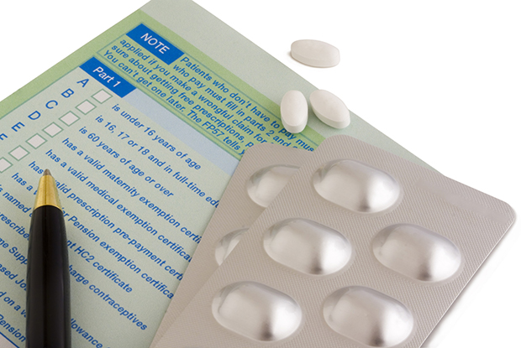
Overview Part 7
Prescribing and Prescribing Security
Notes:
Prescribing section
Photograph taken outside most westerly pub in Ireland

Slide 74
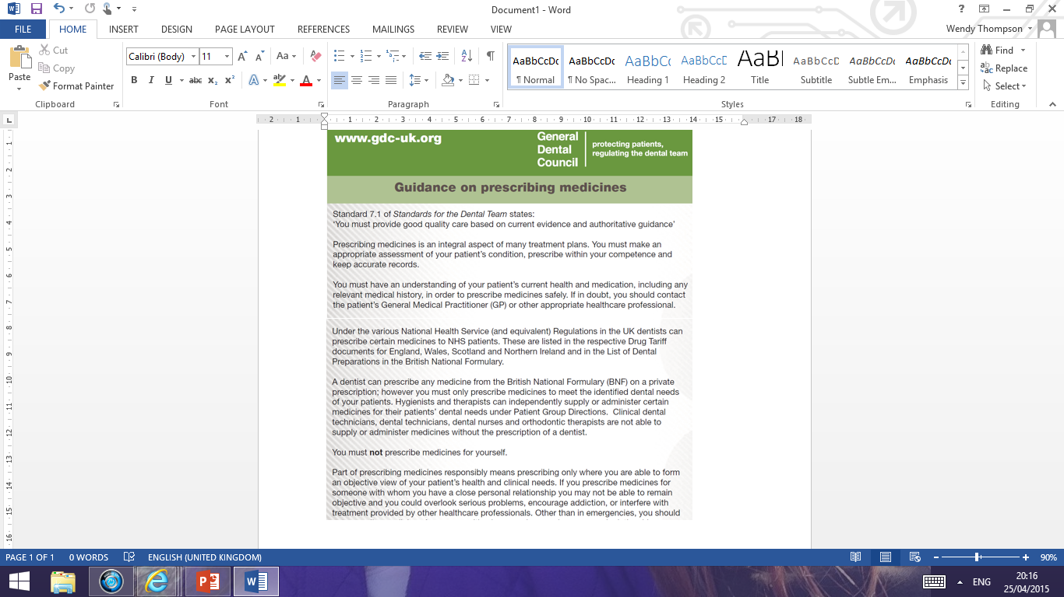
Notes:
GDC has issued a leaflet giving specific guidance on prescribing medicines
Can be down loaded from the website
Themes we’ll see coming through the rest of this presentation:
Only prescribe within your competence
Keep accurate records – including diagnosis to identify the dental need

Slide 75
What can dentists prescribe?
For all prescriptions, dentists should only prescribe medication
that has uses in dentistry NOT for “fear of flying” or to ease back pain
to meet the dental needs of the patient clinically appropriate
that he/she is competent in prescribing BDS
Notes:
NHS patients
Dentists can prescribe any medication in the DPF on an NHS Rx
Dentists can prescribe any medication not in DPF on a private
prescription (or purchase OTC)
Private Patients
Private Rx or purchase OTC

Slide 76
Points to Consider when Prescribing
Is prescribing necessary: risks v’s benefits
Check Medical History
Caution in potential high-risk groups eg
Pregnancy/Breastfeeding
Elderly
Children
Patients on anticoagulants
Adequate information should be provided to the patient eg clear instructions, benefits of medication, potential side-effects and suitable disposal
Notes:
Medicines should be prescribed only when they are essential and, in all cases, the benefit of administering the medicine should be considered in relation to the risk involved. This is particularly important during pregnancy where the risk to both mother and foetus must be considered (for further details see Appendix 4 of the BNF, Pregnancy).
Medical histories should be checked and updated at the start of each new course of treatment and, ideally, reviewed at each patient visit. Knowledge of the medicines being taken by a patient will allow you to check for any drug interactions before prescribing or supplying medicines in connection with the patient's dental treatment.
The doses stated in the BNF are intended for general guidance and represent, unless otherwise stated, the usual range of doses that are generally regarded as being suitable for adults. Medicines suitable for use with children will have the recommended range of doses against individual entries in the BNF. See children’s BNF.
Old people, especially the very old, require special care and consideration when they are being prescribed medicines. Drug therapy of this group is complicated by the physical and mental changes that accompany old age. Also issues such as polypharmacy and unable to swallow tablets?
All patients should be told how to dispose of any medicines that are no longer required, for example, by returning them to the community pharmacist. Medicines should not be disposed of via the sewerage system (for environmental reasons), through the domestic waste system or shared with others.

Slide 77

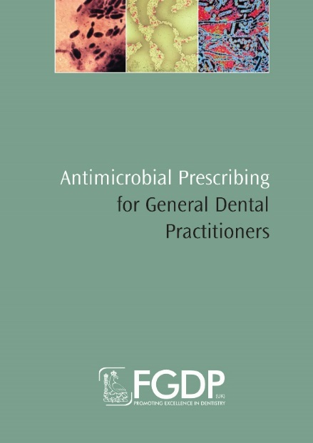
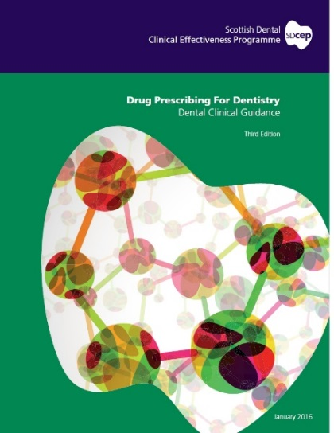
Useful references and authoritative guidance

Slide 78
Writing Prescriptions
For all NHS and private prescriptions, including CDs, the prescription must:
be written (or printed) in indelible ink
be signed in ink by the prescriber (ensure legible)
be dated
specify the prescriber’s address and profession
include the name and address of the patient
For POMs, include the age / date of birth for children under 12 years
Include details of the medication including appropriate quantity and clear dosage instructions
Notes:
Avoid the unnecessary use of decimal points. Quantities of 1
gram or more should be written as 1g etc. quantities of less than
1 gram should be written in milligrams e.g. 500mg, not 0.5g
When decimals are unavoidable, a zero should be written in front of
the decimal point where there is no other figure e.g. 0.5ml, not .5ml
Dose and frequency should be stated; for preparations to be taken
‘as required’ a minimum dose interval should be specified
The names of medicines and preparations should be written clearly
and not abbreviated, using approved titles only
The quantity to be supplied should be clear. The number of days
treatment should be indicated in the box provided on the NHS forms

Slide 79
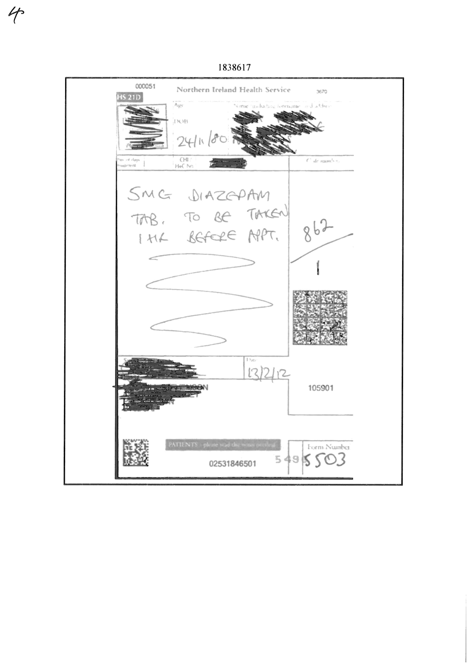

Slide 80
Health Service and Private Patients
Health Service patients
Dentists can prescribe any medication in the Dental Formulary (in the BNF) on an HS21D prescription
Private Patients
Dentists can prescribe any medication in BNF on a private prescription (for a dental condition only). If the medication is a Schedule 2 or 3 CD, you need a PCD1 prescribing form
patients can also purchase OTC if not POM
Notes:
There are no limitations on the number or type of medicines that you dentists can administer or prescribe to a private patient under your care although dentists have an ethical responsibility to restrict your prescribing to areas in which they are competent.

Slide 81
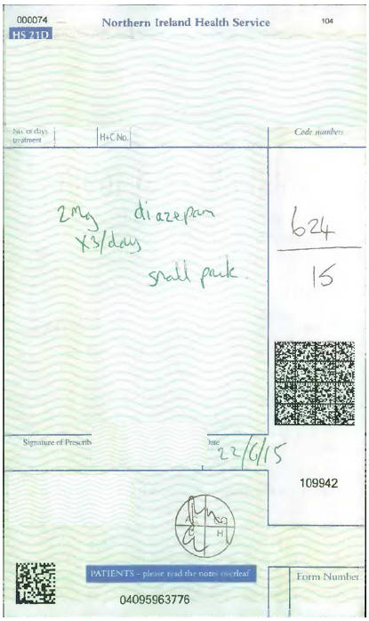

Slide 82
Product Code HS21D –note 6-digit number above this box- useful to check sequence for missing scripts
Cypher number = 10 + DS number
1 pad with 100 scripts in each

Slide 83

BSO Prescription order process
https://bso.hscni.net/directorates/operations/family-practitioner-services/dental-services/contractor-information/dental-prescribing-guidance/prescription-forms/
Online form for ALL primary care orders
DLRT (NI) Ltd in Lisburn
Secure delivery

Slide 84
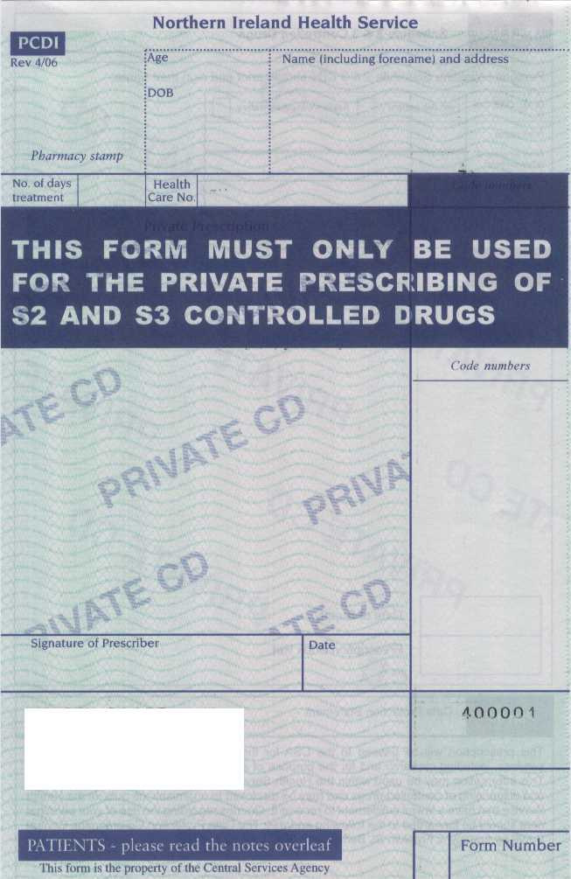
Private Patient Prescription Forms for CDs
PCD1 Forms
Obtained through BSO application process
Prescribers must have a unique prescriber identification number

Slide 85
Prescription Security
Avoid ‘excessive prescribing’
Draw a diagonal (or spiral) line across the blank part of the form
For medication prone to abuse (CDs), write the quantity in words and figures
Ensure alterations are clear and initialled
Add in ‘two or three items only’ where appropriate
Make sure to familiarise yourself with and adhere to the individual practice protocol
Notes:
Blank NHS prescription forms are of considerable value and should be stored securely. The stealing and misuse of prescription forms could be minimised by the following precautions:
do not leave the prescription pad visible or unattended if called away from the surgery; when not in use, keep prescription forms in a locked drawer within the surgery
draw a diagonal line across the blank part of the form under the prescription
write the quantity in words and figures when prescribing medicines that might be prone to abuse – this is obligatory for Controlled Drugs
alterations are best avoided but if any are made they should be clear and unambiguous; add initials against alterations
if prescriptions are to be collected they should be kept in a safe place
The Practice should have a written protocol signed up to by all staff outlining procedures for the management of prescription security
A register should be maintained detailing information about prescriptions ordered, received and taken for use.
Nominated person(s) should be appointed to take responsibility for prescription security procedures

Slide 86
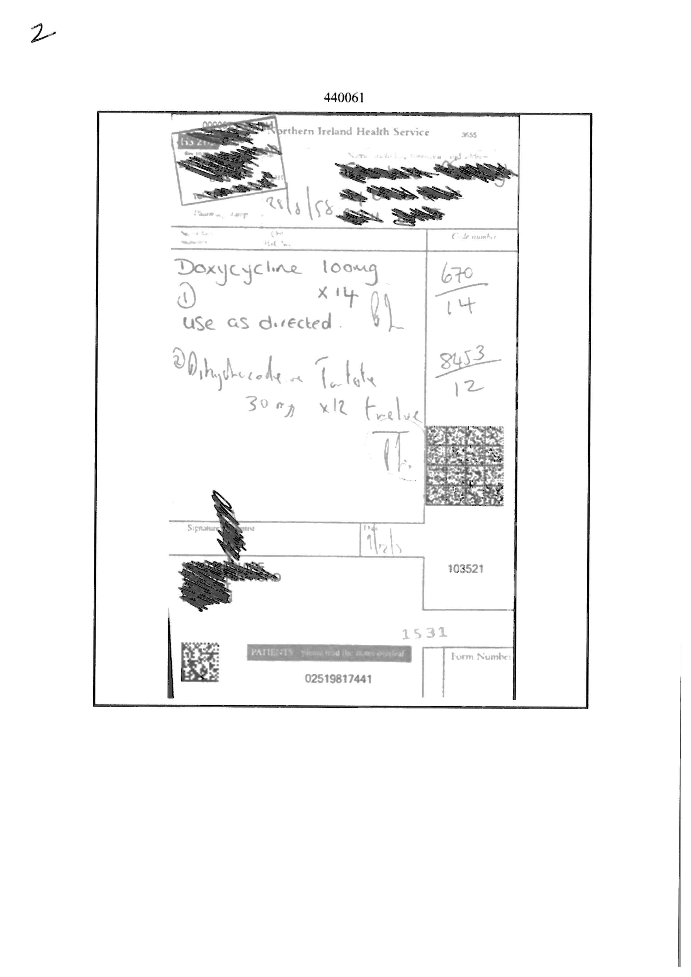

Slide 87
Prescription Costs
Approximately £40 to cover all costs for processing a prescription from printing to pharmacy and BSO.
Does not include the cost of the actual medicines
Alternatively!
Paracetamol to purchase over the counter (OTC) 25p to £3.00

Slide 88
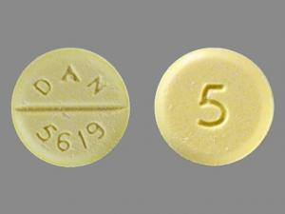
CD Monitoring
Community pharmacists forward dispensed private and NHS prescription forms to the BSO
The SPPG is responsible for monitoring CD prescribing (BSO data used) on behalf of the NI CDAO
Please see dental Prescribing page of BSO website at:
https://bso.hscni.net/directorates/operations/family-practitioner-services/dental-services/contractor-information/dental-prescribing-guidance/
Notes:
After the community pharmacist dispenses the NHS/PCD1 form they submit it to the BSO. The HSCB is responsible for monitoring private and NHS controlled drug prescribing; data to enable this is made available to the HSCB by the BSO

Slide 89
Drug | Quantity to be queried
Diazepam 2mg / 5mg tablets | > 10 tabs per script
Diazepam 10mg tablets | Any quantity per script
Diazepam liquid 2mg/5ml | Quantity > 50ml
Temazepam 10mg/20mg | > 5 tabs per script
Temazepam liquid 10mg/5ml | > 20mls per script
Dihydrocodiene 30mg tablets | > 16 tabs or if routinely prescribed i.e. more than 2 prescriptions / month for quantity > 16 tabs

Slide 90

If the worst happens!
Contact:
PSNI on 101
BSO Counter Fraud and Probity (CFPS)
0800 096 3396 https://cfps.hscni.net/report/
SPPG – area assistant business support manager
Submit Adverse Incident form to SPPG
Gerry Cleary, dental adviser, 02895 361006 - help with forms

Slide 91

Antimicrobial Stewardship What happened during the Pandemic? Advice – Analgesia - Antibiotics

Slide 92
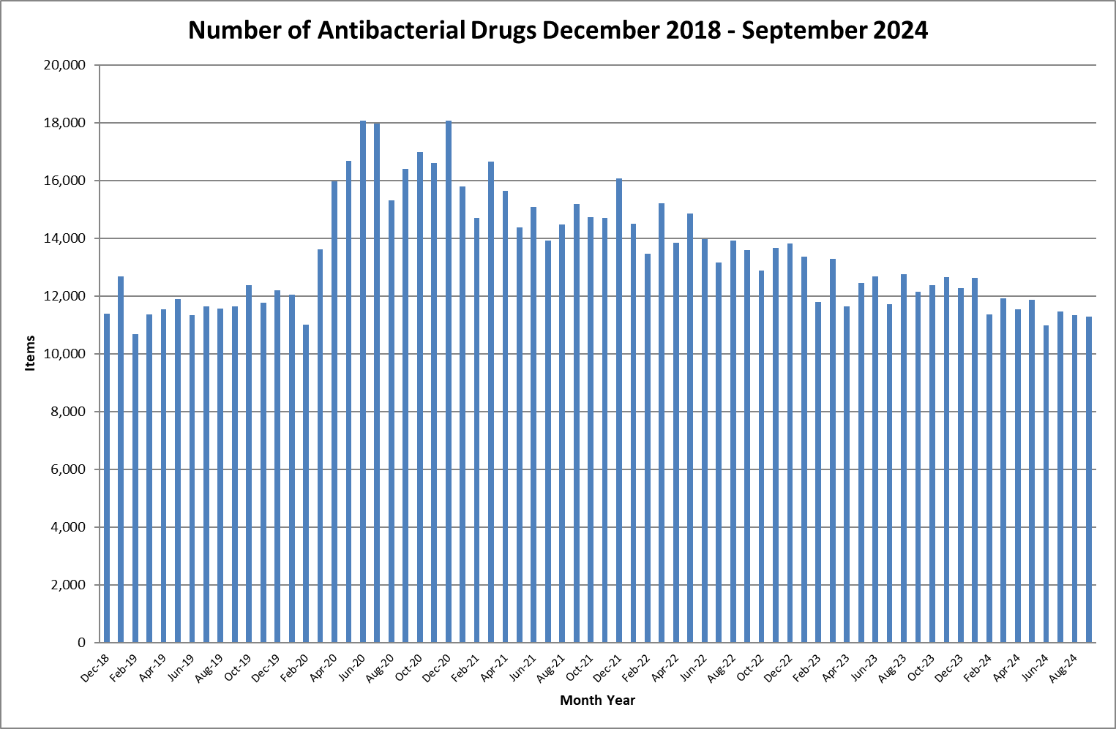

Slide 93
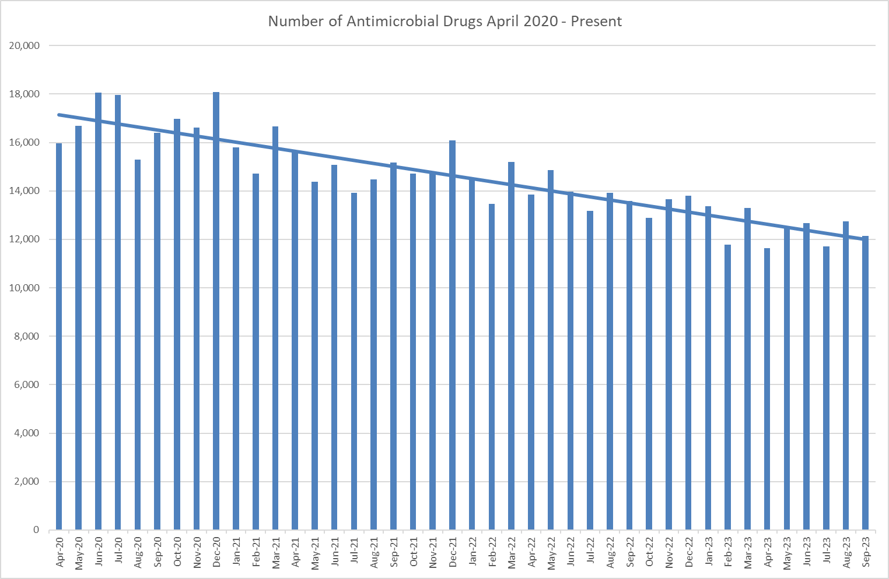

Slide 94
Number of dispensed Antibacterial Drugs December 2018 - Present
 | Year
 | 2018 | 2019 | 2020 | 2021 | 2022 | 2023 | 2024
Jan |  | 12,685 | 12,054 | 15,789 | 14,499 | 13,372 | 12,632
Feb |  | 10,668 | 11,017 | 14,707 | 13,454 | 11,779 | 11,363
Mar |  | 11,351 | 13,616 | 16,660 | 15,203 | 13,293 | 11,918
Apr |  | 11,527 | 15,971 | 15,626 | 13,841 | 11,634 | 11,534
May |  | 11,892 | 16,684 | 14,378 | 14,860 | 12,445 | 11,870
Jun |  | 11,339 | 18,064 | 15,084 | 13,958 | 12,668 | 10,982
Jul |  | 11,649 | 17,972 | 13,926 | 13,169 | 11,707 | 11,453
Aug |  | 11,555 | 15,297 | 14,486 | 13,923 | 12,750 | 11,328
Sep |  | 11,629 | 16,402 | 15,183 | 13,586 | 12,135 | 11,285
Oct |  | 12,375 | 16,968 | 14,727 | 12,886 | 12,375
Nov |  | 11,758 | 16,606 | 14,711 | 13,666 | 12,655
Dec | 11,374 | 12,189 | 18,080 | 16,077 | 13,803 | 12,279

Slide 95
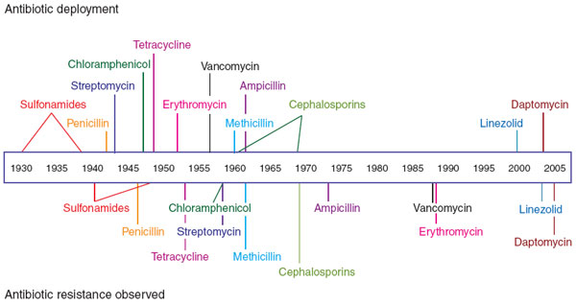
Observation of antibiotic resistance

Slide 96
Full details on BSO website
‘Prescribing page’
https://bso.hscni.net/directorates/operations/family-practitioner-services/dental-services/contractor-information/dental-prescribing-guidance/

Slide 97
Useful websites
HS48 and HS50 forms, Minimum Standards for Dental Care and Treatment https://bso.hscni.net/directorates/operations/family-practitioner-services/dental-services/contractor-information/new-entrants-to-the-ni-dental-list/
https://bso.hscni.net/directorates/operations/family-practitioner-services/dental-services/contractor-information/forms-library/
Statement of Dental Remuneration https://bso.hscni.net/directorates/operations/family-practitioner-services/dental-services/dental-charges-fees/statement-of-dental-remuneration-sdr/ Other websites that may be of use https://www.health-ni.gov.uk/topics/dentistry https://online.hscni.net https://bso.hscni.net/ http://www.hse.gov.uk/risk/index.htm www.rqia.org.uk
www.gdc-uk.org

Slide 98
Contact Numbers:
Directorate of Integrated Care:
Northern Office 028 953 62849
Belfast Office 028 953 63926
South East Office 028 953 63926
Southern Office 028 953 62104
Western Office 028 953 61010

Slide 99
Thank you for your attention

